Slide 1
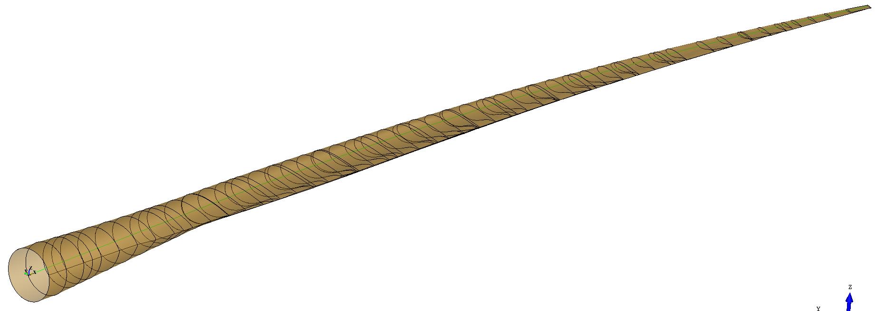
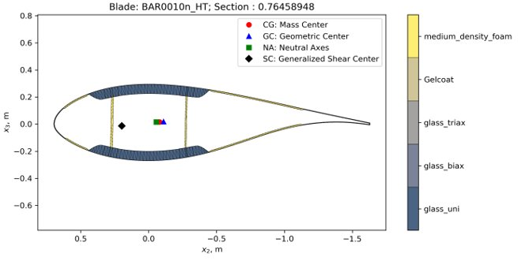
Inflatable Blade Structural Analysis
BAR baseline blade:
Currently using BAR001(?) for robustness and stable design
When slender blade (BAR003?) is available,
will switch to it as baseline
Parameters:
24% thick airfoil @ 76.5% span
Primarily glass and foam
Parameter | Value
EIflap | 2.86E+08
EIedge | 7.66E+08
GJ | 2.74E+07
Section mass | 264.5

Slide 2
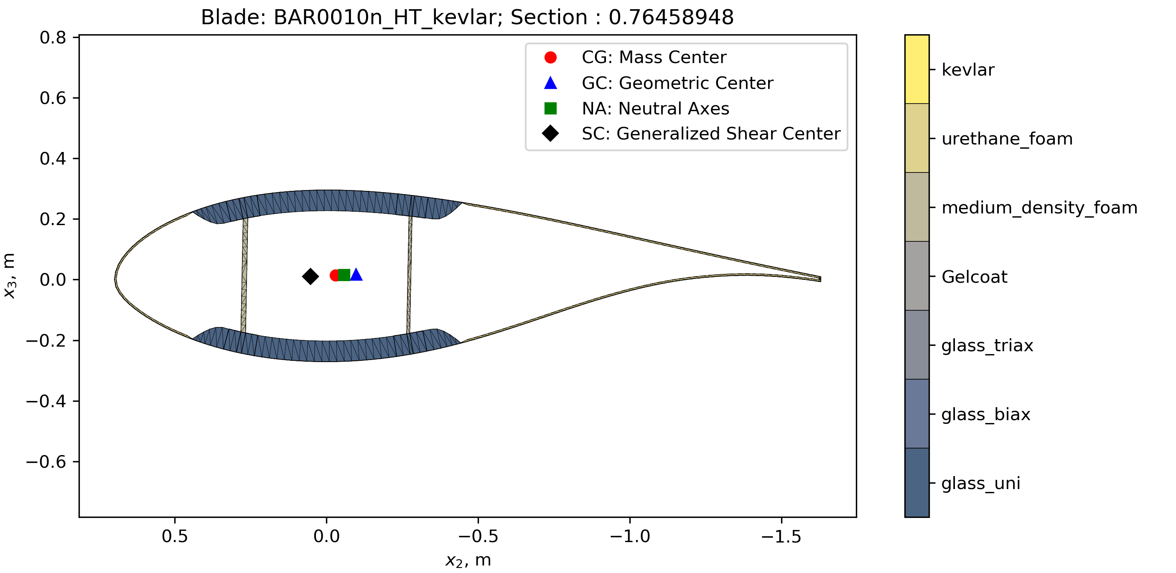
Inflatable Blade Structural Analysis – Step 0.5
Optimized shell only, kept identical beams and webs
Glass → Kevlar, medium density foam → injectable foam
Removed LE & TE reinforcements
Optimization variables:
Shell thickness
Optimization objectives:
Maintain flap, edge, torsional stiffness
Parameter | Value
EIflap | +2.76%
EIedge | -1.18%
GJ | -72.24%
Section Mass | -11.48%

Slide 3
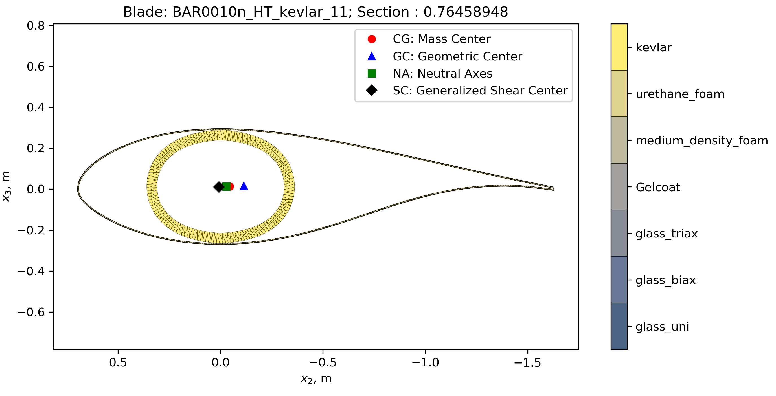
Inflatable Blade Structural Analysis – Step 1
Use optimized shell from Step 0.5, optimized primary structure
Replaced webs and beams with ellipsoidal structure
Optimization variables:
Ellipse chord
Ellipse thickness
Material orientation (FW only)
Optimization objectives:
Maintain flap, edge, torsional stiffness
Minimize mass
Next Steps:
Perform structural optimization
This is not an optimized result!

Slide 4
Outlook & Ongoing Work
Using Step 0.5 as baseline for the following structural optimization
Step 1a – Filament wound optimization using Carbon optimize thickness, ellipsis stretching parameter, and material orientation
Step 1b – Traditional materials (glass, foam, glass)
optimize thickness, ellipsis stretching parameter
Step 1c – TBD
Step 2.0 – Exclude the shell and create new baseline from most realistic & promising result based on step 1 studies
Step 3.0 – (If needed) Add central straight web if insufficient stiffness

